Slide 1
Tribes, Chiefs, and Transhumance:
A Comparative Institutional Analysis
Jeffrey Nugent
Nicolas Sanchez
1993

Slide 2
Arid and Semi-Arid Regions (ASARs)
Poor land quality
Low population density
  Scarce labor
Simple technology
Extreme seasonality
  Rainfall and production

Slide 3
ASAR Characteristics Imply
Land has low value
  In surplus supply
Property rights in land do not exist
Transport and communication costs are high
  So markets are small, local, volatile, sensitive to weather shocks

Slide 4
ASAR Characteristics Imply
Resource accumulation is mainly movable assets
  Livestock
Animal husbandry is less labor intensive than agriculture - tends to dominate
Market failures in credit and insurance markets
Foodstuffs common in consumption bundles of locals

Slide 5
Privately Owned Herds Are Relatively Large
Given
  Availability of pasture land from the commons at no cost
  Economies of scale in animal supervision
  Substantial risks of severe animal loss due to drought
To assure survival in the long-run
Often herds larger than what expected based on average income that the herd generates

Slide 6
Transhumance
Success requires animals to be moved long distances in the course of the year
Extreme weather and pasture availability
Skill and mobility different from agriculture

Slide 7
Overlooked in Existing Analysis
Product markets are necessary in ASARs
  Transhumance dominates in ASARs
    Need to specialize rather permanently
      Specialization on certain types of animals and agriculture
    Primitive agricultural technology of ASARs
      Mixed farming not feasible

Slide 8
Overlooked in Existing Analysis
Dominant transhumant activities take place within tribal societies
  Chief plays a critical role in most, but not all
Relevant economies of scale involve externalities

Slide 9
Purpose of Paper
To show that tribes may exist to take advantage of external economies of scale inherent in the conduct of transhumance in ASARs
Also explains why transhumance is sometimes practiced not in tribes or in tribes without chiefs

Slide 10
Purpose of Paper
Paper focuses on interrelationships between these neglected features
  Factors that make tribal institutions essential in some contexts but irrelevant in others
Uses
  Existing theory of external economies of scale
  Club goods (“local public goods”)

Slide 11
Explanations for Transhumance
Many innovative uses of animal staple
Limits risk of disease through dispersion
Animals healthier due to non-sedentary conditions
Delicate pastures in ASARs yield greater carrying capacity when only periodically used

Slide 12
Explanations for Transhumance
Geographic dispersion decreases risk
  Economies of scale in animal supervision but also in risk reduction but these partly external to individual herdsman
    Not necessarily taken into consideration in individual decisions with respect to allocation of land
Absence of law and order
  Implies assets more vulnerable to damage/theft
  Vulnerability to theft decreases with mobility of assets

Slide 13
Institutional Problems Transhumance
Security
  Thin population makes it uneconomic for state to provide adequate law and order
  Accentuated by
    Animals being easy targets
    Easy border access for escaping
Risk of nature variability
  Droughts especially
    Terms of trade of meat for grain fall
  Rebuilding a loss in the herd is slow
    Rate may be less than natural state due to post-drought conditions

Slide 14
Institutional Problems of Transhumance
Severe competition among herdsmen for high quality pastures and water
“Tragedy-of-the-commons”
  Overgrazing, desertification, ecological decline
Other external threats
  Animals that prey on livestock or pastures
Conflict between herdsmen and farmers
  High cost of fencing, need for traverse, proximity of trails to farms
  High transaction costs

Slide 15
Variables
ASAR with two outputs produced by individual household i
  A = Agriculture
  H = Animal husbandry
Inputs
  L = Labor
  K = Land (water and pasture)

Slide 16
Production and Utility Functions
Cobb Douglas production function (CRTS)
  A_{i} = E_{A}K_{Ai}^{(1-α)}L_{Ai}^{α}
  H_{i} = E_{H}K_{Hi}^{(1-β)}L_{Hi}^{β}
    E_{A}, E_{H} are technical efficiency parameters
    Output elasticities reflect factor intensities
Cobb-Douglas utility function
  U_{i} = A_{i}^{γ}H_{i}^{1−γ}

Slide 17
Aggregate Production and Utility Functions
Assuming
  Each household is identical
  Other requirements for aggregation of utility functions satisfied
    A = E_{A}K_{A}^{(1-α)}L_{A}^{α}
    H = E_{H}K_{H}^{(1-β)}L_{H}^{β}
    U = A^{γ}H^{1−γ}

Slide 18
Resource Constraints
Assume relevant resources are fixed in supply
  K_{A} + K_{H} = K
  L_{A} + L_{H} = L

Slide 19
Transformation Function
Combine
  Aggregate production and utility functions
  Resource constraints
Assume
  A is more labor intensive
  H is more land intensive
    α > β
  Transformation curve: PP

Slide 20
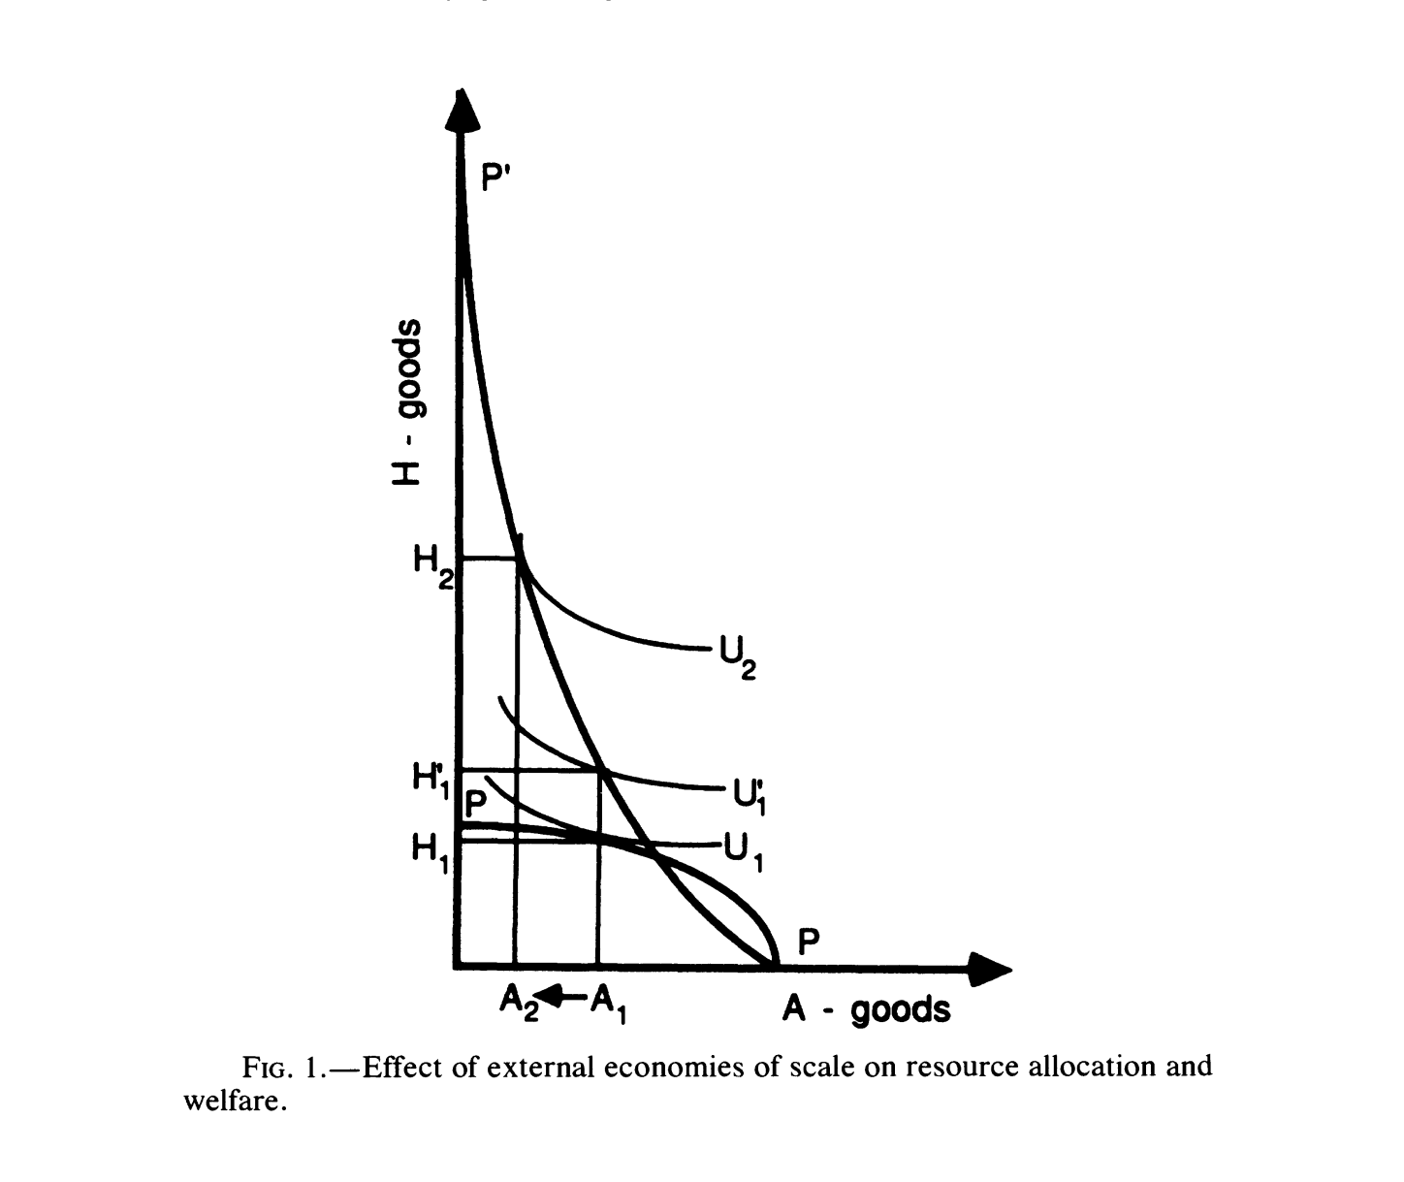
Production and Utility

Slide 21
Maximization of Aggregate Utility
Max U₁ with respect to A, H, K, L
  Optimal amounts produced and consumed
    (A₁, H₁) on PP

Slide 22

Max U₁: (A₁, H₁)

Slide 23
External Economies of Scale in H
Larger amount of land allocated to H =>
Lower amount of K each herdsman would need to obtain his target amount of H
This gain arises
  Not because he would need fewer animals and less land to obtain desired amount of meat
  Because all other herdsmen would require fewer animals and less land
    Leaving more for him

Slide 24
External Economies of Scale in H
Given variation in local weather
  Individual herdsman needs less grazing land per unit of meat output H to produce any given amount of meat the larger the land area is to which he and his fellow herders would have access in times of bad weather
External to the individual herdsman
  Increase land available to others

Slide 25
External Economies of Scale in H
At societal level, production of H:
  H = K^{β1}L^{β2}
    Where β₁ + β₂ > 1
Transformation curve extends from P out to P’
New point of tangency
  (A₂, H₂)

Slide 26

P to P’ => (A₂, H₂)

Slide 27
New Point of Tangency
(A₂, H₂) =>
  Greater specialization in animal husbandry
  Higher level of social welfare (U₂)
Note: PP’ can be bowed in or bowed out

Slide 28
(A₂, H₂) Allows U₂

Slide 29
External Economies of Scale
Because external to individual herdsman
  Each identical herdsman would neither
    Take such economies into consideration nor
    Have access to them
Hence, each would decide on allocation consistent with (A₁, H₁)
  Point of tangency of perceived PP and U₁

Slide 30
External Economies of Scale Realized
Suppose existence of a tribe
Each individual in tribe agrees to share grazing rights on his parcel for grazing rights on all other parcels
This minimizes production risk of each member by treating all grazing land as communal
Thus PP’ can be realized

Slide 31

P to P’ => (A₂, H₂)

Slide 32
The Need for Chief
Tribe needs to allocate land between A and H
Role of the chief
  To make use of PP’
  Set aside land for H activities (K_{H}) consistent with H₂
Chiefs often wealthy, with most livestock
  Incentive to internalize externalities
  Means and power to exercise leadership

Slide 33
Implications
Increase in endowment of land relative to labor or preferences for animal products (1-γ) => increase relative importance of H
Decline in land quality =>
  Lower both 1-α and β₁
  Raise the weather risk
    Raise importance of the externality and difference between individual and tribal allocations

Slide 34
Implications
Rise in E_{A} relative to E_{H}
  Ex: improvements in dry farming
  Lower relative importance of H
Market with A and H exchangeable
  Choice between A and H affected by exogenously determined terms of trade

Slide 35
Tribe and Free Riding
If external economy internalized
  Improve welfare of tribe
Non-members have incentive to free ride
  And any herdsman has incentive to keep others away
Existence of tribe and intervention by chief has a public good character

Slide 36
Tribe and Free Riding
Explicit rules for tribal membership
Severe punishment for free riding outsiders and disobeying insiders
  Negative selective incentives
  Social ostracism
Rules must be flexible to discourage private investments that enhance land productivity

Slide 37
Rules of the Tribe
Once rules created, difficult and costly to change
  Information and transaction costs
Tribal institutions may outlive their usefulness
Tribe may be inefficient with changing conditions
  Ex: change between A and H

Slide 38
Size of Tribe and Territory
Given assumption of endowment L and K
  Need to find optimal size of tribe and territory
Use standard model of local public goods or clubs
  Allows simultaneous determination of K and L
  Or number of members in the tribe [n]

Slide 39
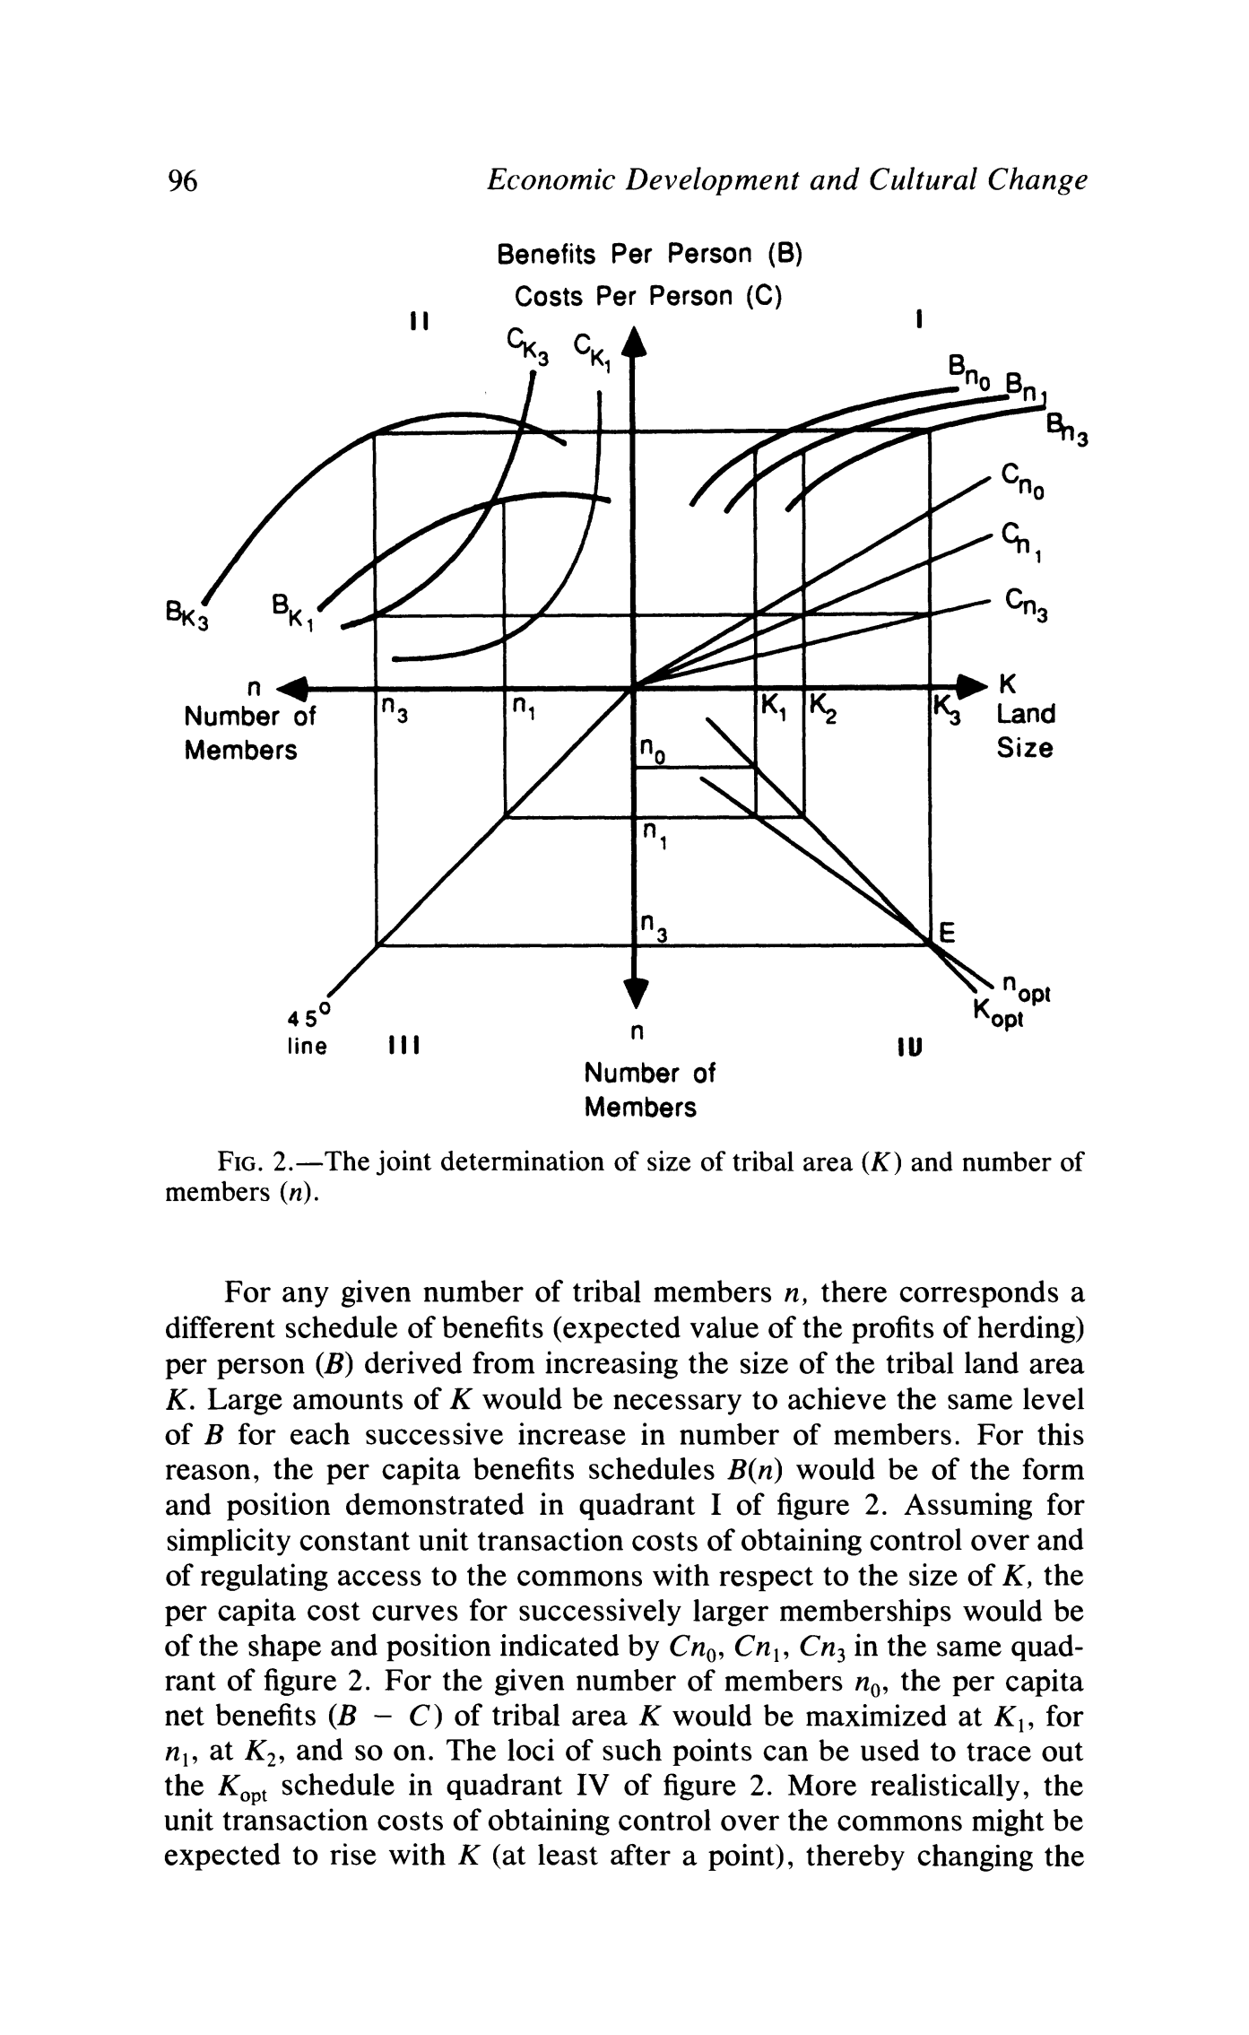
Tribal Area (K) and Members (n)

Slide 40
Per Capita Benefits
For any given n, corresponds schedule of benefits per person (B)
  B = Expected value of profits from herding
  Derived from increasing K (tribal land)
Larger amounts of K necessary to achieve same level of B for each successive increase in n

Slide 41

Per Capital Benefit: B_{n}

Slide 42
Per Capita Cost
Assuming constant unit transaction costs of control and regulation to commons with respect to K
Per capita cost for larger memberships (C_{n})

Slide 43

Per Capita Cost (C_{n})

Slide 44
Optimal K given n
For given number of members n₀
Per capita net benefits (B – C) of tribal area K
Maximized at K₁
  for n₁ at K₂
Loci of these points used to trace K_{opt}

Slide 45

Optimal K (K_{opt})

Slide 46
Transaction Costs
Unit transaction costs of obtaining control over commons expected to rise with K
  Changing magnitude of (B – C)
  Changing slope of K_{opt}

Slide 47
Optimal n given K
For given size tribal area K
  Per capita benefits (B_{K})
  Per capita costs (C_{K})
    Both with respect to number of members of the tribe (n)
Maximum (B – C) attained by
  Equalizing slopes of B_{K} and C_{K}
    K = K₁, B – C is max at n₁
    K = K₃, B – C is max at n₃
Loci of these points trace out n_{opt} curve

Slide 48
Optimal n (n_{opt})

Slide 49
Equilibrium
At point E, where K_{opt} and n_{opt} meet
Any point of disequilibrium would give rise to pressures with would induce convergence toward equilibrium.

Slide 50
Equilibrium E

Slide 51
Implications of Simplification
Non-members of the tribe
Private and public goods producible within tribe
Differential tastes and preferences
Nature and magnitudes of exclusion costs
Effects on different generations
Other dynamic issues

Slide 52
Dynamics
Reduction in quality of land and/or increase in local variability of rainfall
  Shift B_{K} down and right for each n
    Especially for higher levels of n
  Upward slopes of B_{K} increase for each level of K
  C_{K} flattened out
    Narrowing gaps between them at each level of K
  Shift K_{opt} outward and flattening it

Slide 53
Dynamics
Lower quality of land and greater local variability in rainfall
  Shifting B_{n} downward
    Especially at lower levels of K
  Shifting n_{opt} upward and right
    Likely that the size of the tribal territory K rise while n would fall

Slide 54
Dynamics
Increase in leadership quality of the chief or in communications skills among members
  Shift C_{n} downward and right for each K
    Especially at high levels of n
  Shift n_{opt} downward and left
  Raising both K and n

Slide 55
Tribes With Chiefs:
Tuareg of Central Western Sahara
Extraordinary size of land
  Low quality of land
  High risk of drought
  Importance of external economies of scale in risk reduction
Extremely hierarchical
  Chiefs to wealthy camel owners to herdsmen…
  Better cope with drought

Slide 56
Tribes With Chiefs:
Native Reserves of Botswana
Provides empirical support for
  External economies of scale in H
  Relative efficiency of tribal institutions in internalizing these economies
    Raising welfare of tribal members
Explains why
  private property dominant in A
  but common property dominant in H

Slide 57
Tribes With Chiefs:
Rwala of Syria, Jordan and Iraq
Dominated region for last several centuries
Khawa payments
  Protection against raids by outsiders
  Discriminatory tax on A of non-Rwala relative to H of Rwala
Technology and industrialization changing institutional framework

Slide 58
A Tribe With No Chief:
The Al-Murrah of the Arabian Empty Quarter
“Nomads of the nomads”
No water
  Less competition for extremely poor land
  Security is less a concern
Access to 20 wells by lineage
  Limits importance of free riding
No possibility of A, so no optimal allocation for a chief to decide

Slide 59
Grazing Areas With Neither Tribes nor Chiefs: The Shahsevan of Iranian Azerbaijan
Private property
  Seasonal weather – transhumance
  Weather patterns predictable
    Winter and summer land given to individuals and camps
  Inheritable rights
    Incentive for land-improving investments
    Household or camp-level economies of scale

Slide 60
Grazing Areas With Neither Tribes nor Chiefs: The Central Asian Arabs of Afghanistan
Tribal institutions changed over time
  Three-step transhumance (plain-steppe-mountain)
  Predicable weather: private property
  Russia took control of lands in 1860s
    Converted into cotton
  Forced to low quality pastures but tribal institutions strengthened
  1920s: given individual land rights by state
Exception: Katopoi has strong tribal institution
  Poorest clan with least dependable land

Slide 61
Conclusion
Evidence of economies of scale in form of decreased inventories of animals per unit of land
Size of tribal area and allocation of land between A and H seem to vary according to exogenous environmental conditions
Technological changes undermine role of tribal institutions
Lower quality of land or more variable the weather, the more important land is communal (tribal)

Slide 62
Conclusion
Greater external security problems and larger the area, larger the number of members or greater their relative military strength needs to be
  If agriculture and animal husbandry not competitive, zoning function of chief becomes redundant – tribe with no chief
  If agriculture and animal husbandry are competitive, zoning is needed

Slide 63
Conclusion
Limits to tribal flexibility
  Response time to price or environmental shocks
Increasing (decreasing) population density shift resource allocation toward A (H)
Absence of state-provided security shows herdsmen must provide that security for themselves – tribes and confederations of tribes form

Slide 64
Conclusion
Colonial and post-independence regimes try to weaken tribal power
  Confiscation of weapons and camels
  Buying off tribal chiefs with private property
  Public investments in well digging, housing
  Encouraging settlement
    Some with good intentions for a prosperous H in long run

Slide 65
Conclusion
These policies have resulted in disaster for transhumance
Collective ownership essential to cohesion of the nomadic group
Can see the basis of heterogeneity in groups and attitudes about various institutional rules, such as property rights, role of government

